Slide 1


Slide 2

Python Modules & Standard Libraries

Slide 3

Python Modules
Module - The Highest level program organization unit which packages program code and data for reuse
Modules provide an easy way to organize components into a system by serving as self contained packages of variables and functions - known as ‘namespaces’
Modules corresponds to file names in python
Modules import other modules to use the names they define
Modules are processed with 2 statements
Importing
Calling functions defined by the modules
Why use modules?
Code Reuse
System Namespace Partitioning
Implementing shared serviced or data

Slide 4
Structure of the Program using Modules

Slide 5
Python Modules Statements
import <mod_name>
import <mod_name> as <m>
from <mod_name> import <attributes names>
importlib.reload(<mod_name>)
Calling
<mod_name>.attributename
How Import Works?
Find the modules file in Search PATH
Home directory of the program
PYTHONPATH
Standard Library Directories
Sys.path and Sys.modules
Compile it into byte code
Run the modules code to build the objects it defines

Slide 6
Python Modules Types
Python Standard Libraries – Part of Python Installation
Comes with 200 modules
Using these modules ensure platform independent code
Third Party Libraries
Packaging using distutils
Installation is through pip3
User Defined Modules
Include in sys.path
Export PYTHONPATH

Slide 7
How Import Works
Find the module’s File
Current Working Directory
PYTHONPATH variable
Standard Library Path
Site packages home of third party extensions
Compile it to byte code
Run the module’s code to build the object it defines

Slide 8
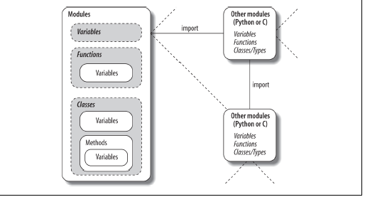
Module Coding Basics
Module name = Module Filename
Application file – import module

Slide 9
Python Module Packages
A directory of python code is called as package
Python import turns directory name to the package module namespace
Directory structure of the package is as follows
/home/user/dir0/dir1/dir2/mod.py
cd /home/user/dir0
import dir1.dir2.mod
Following rules apply for package dir1
dir1 and dir2 must contain __init__.py
dir0 need not contain __init__.py file
dir0 must not be listed in the import statement in the application file
Imports run __init__ files

Slide 10


